Slide 1
Analysis of Crime Incident Reports - Boston
Darshan Mehta

Slide 2
Motivation and Dataset Description
Which is the safest place to stay in Boston?
Crime Incident Reports dataset from published by the Boston Police Department under Open Data Commons Public Domain Dedication and License (PDDL) [link].
Over 438K incidents reported between June 2015 and Nov 2019.
Records 233 different kinds of offenses.
Numbers slightly inflated in this dataset - accounted for.
Stakeholder: Anybody living in or visiting Boston.

Slide 3
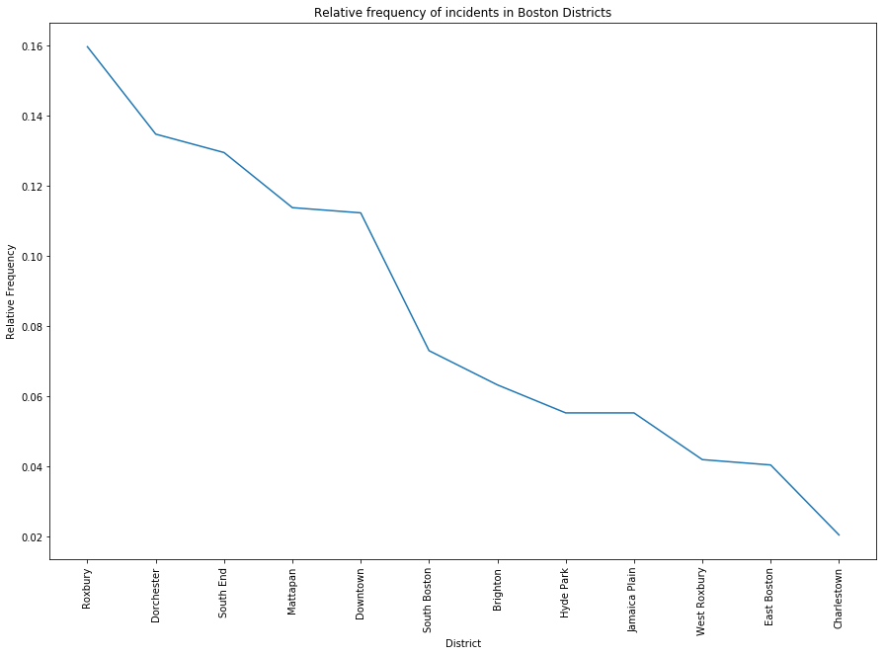
Distribution of incidents across districts
Notes:
A future work would have been to normalize the crimes by the area or number of people in that district.

Slide 4
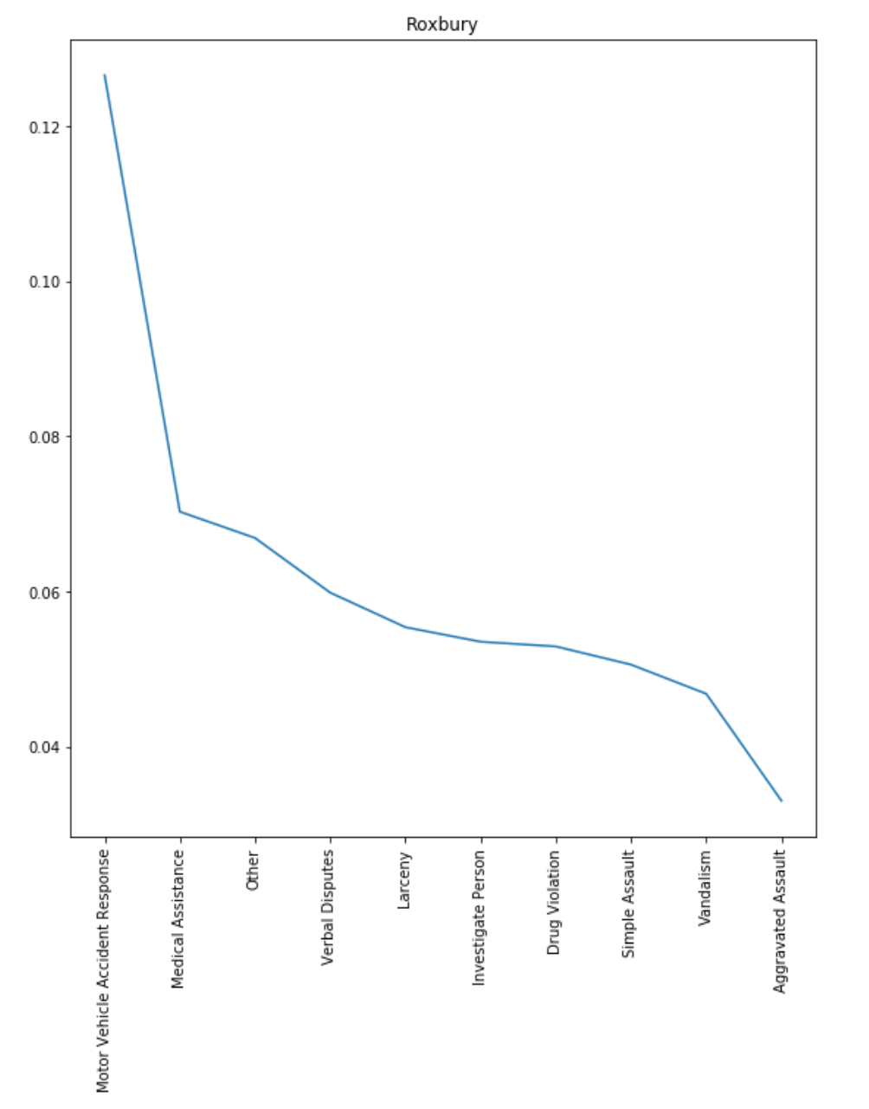
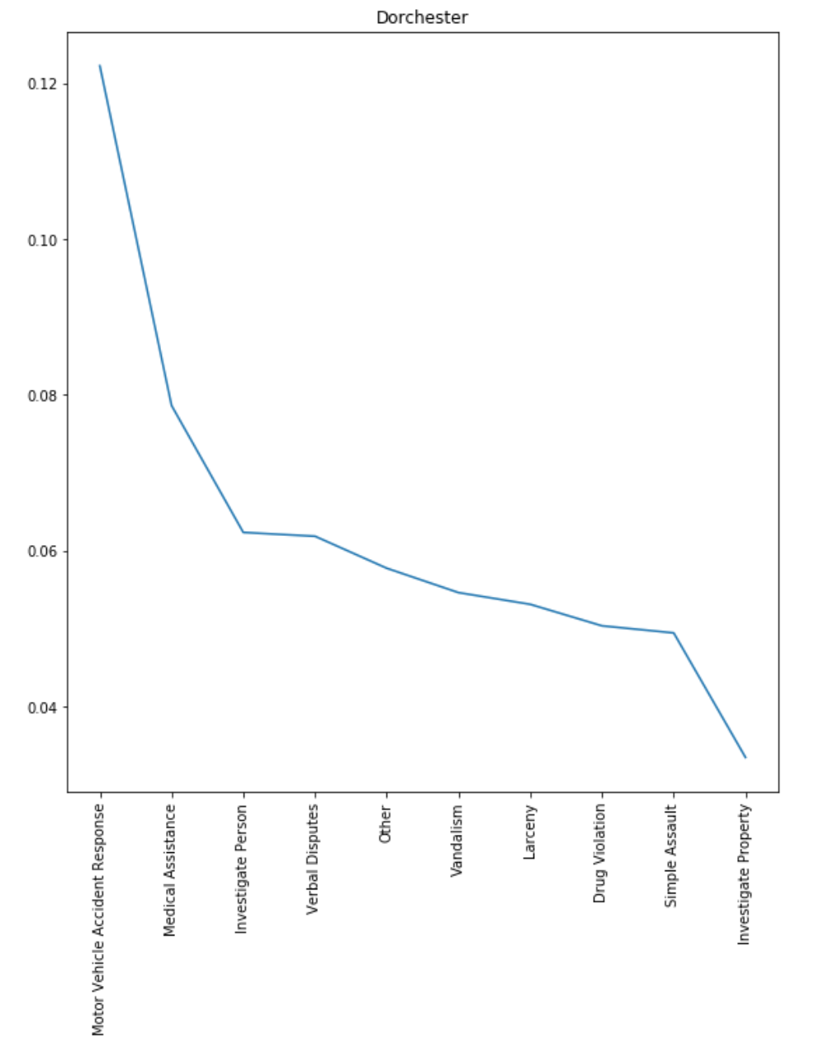
What are the top 10 crimes classified for each district?

Slide 5
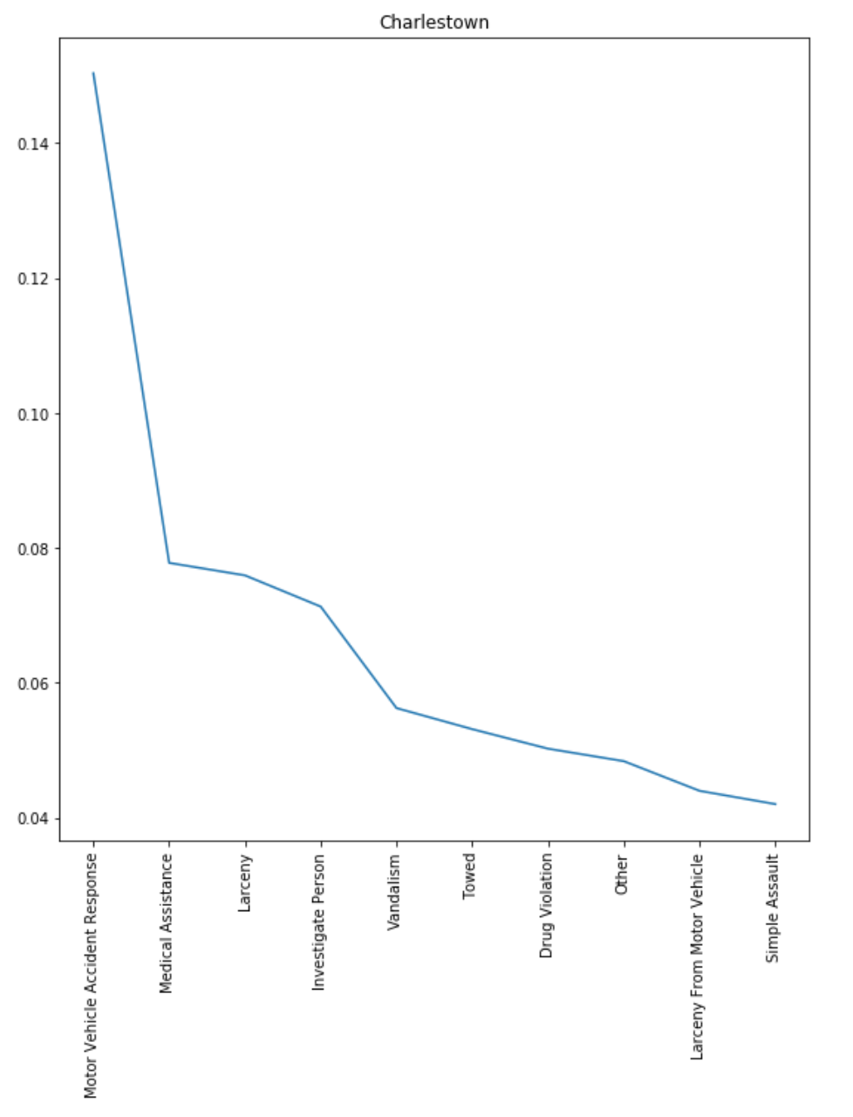
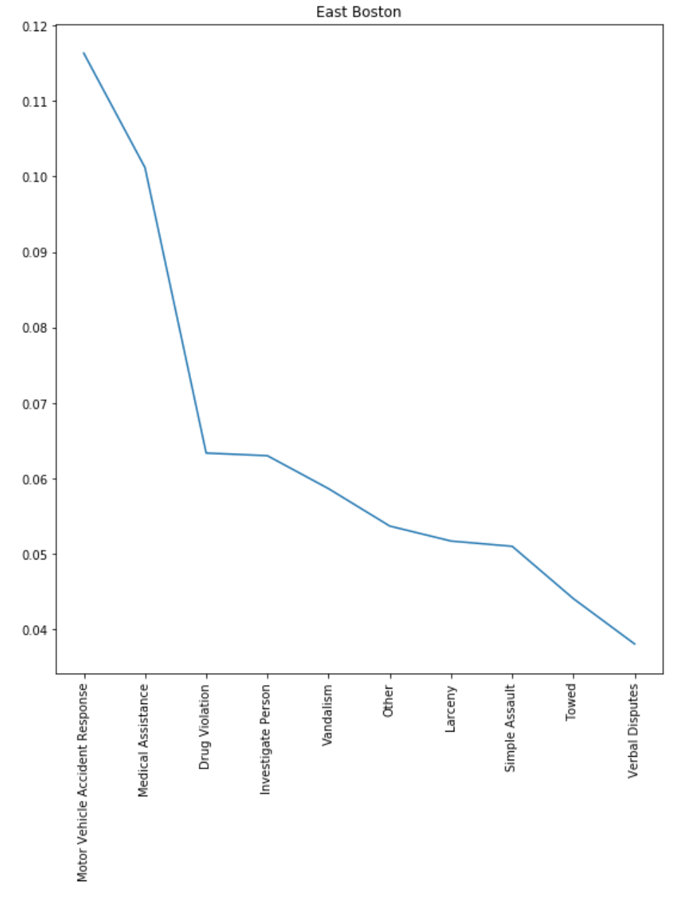
What are the top 10 crimes classified for each district?

Slide 6
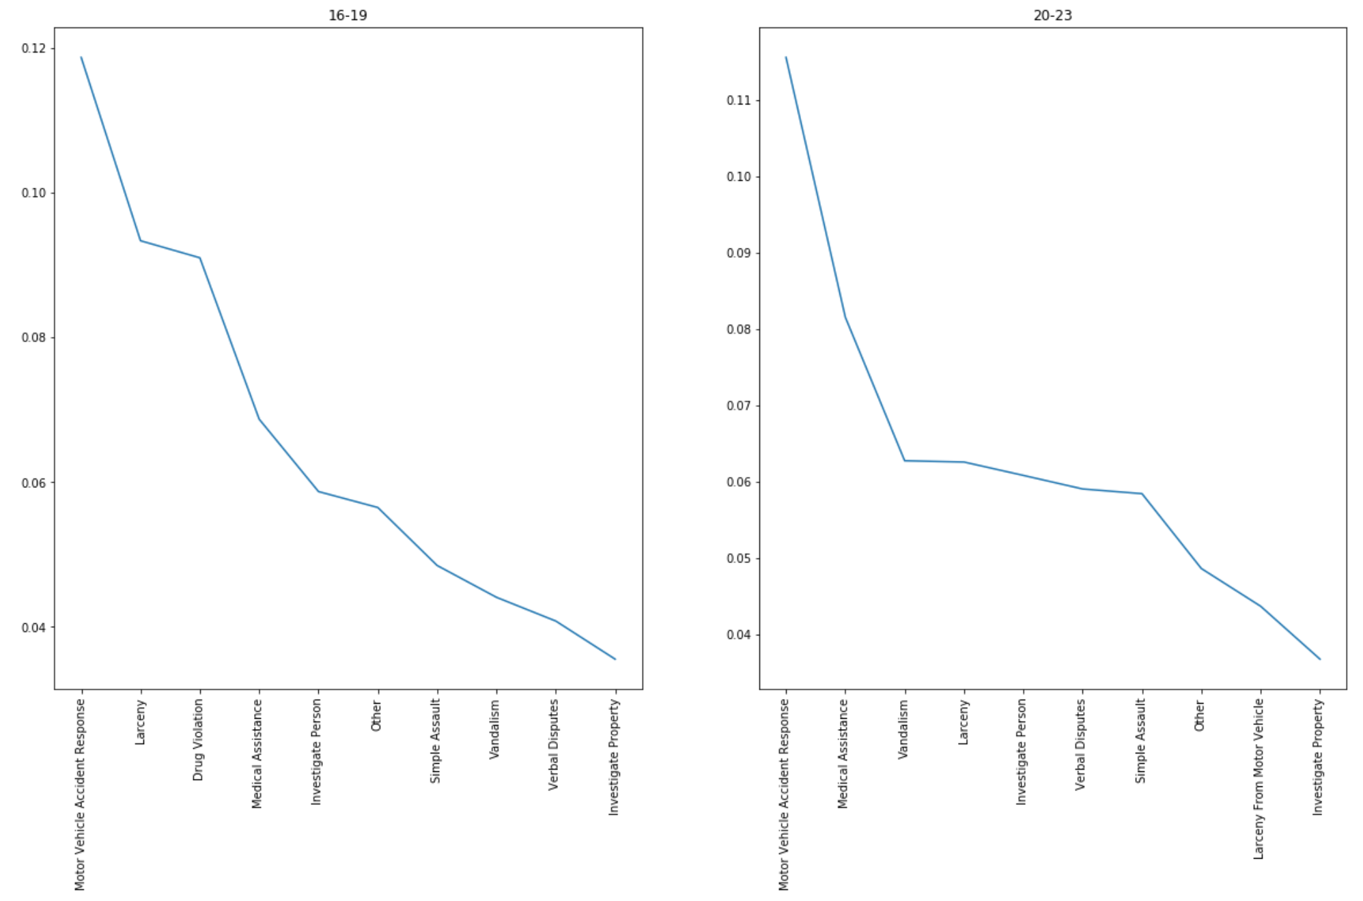
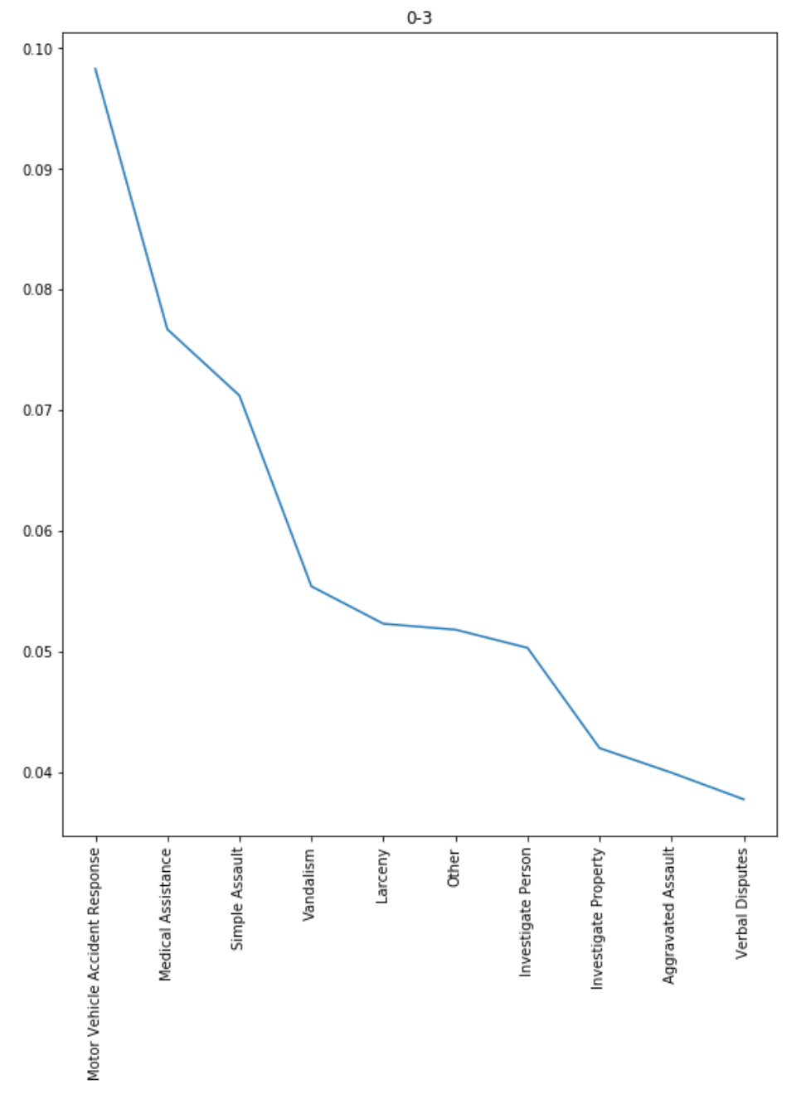
2. What are the top 10 crimes classified according to different times of the day?

Slide 7
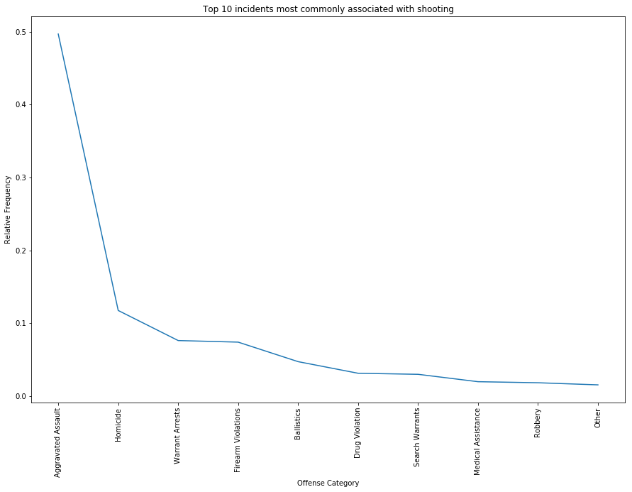
3. What reported incidents are most commonly associated with a shooting?
Hours | Count
20-23 | 461
0-3 | 363
16-19 | 325
12-15 | 192
8-11 | 75
4-7 | 61

Slide 8
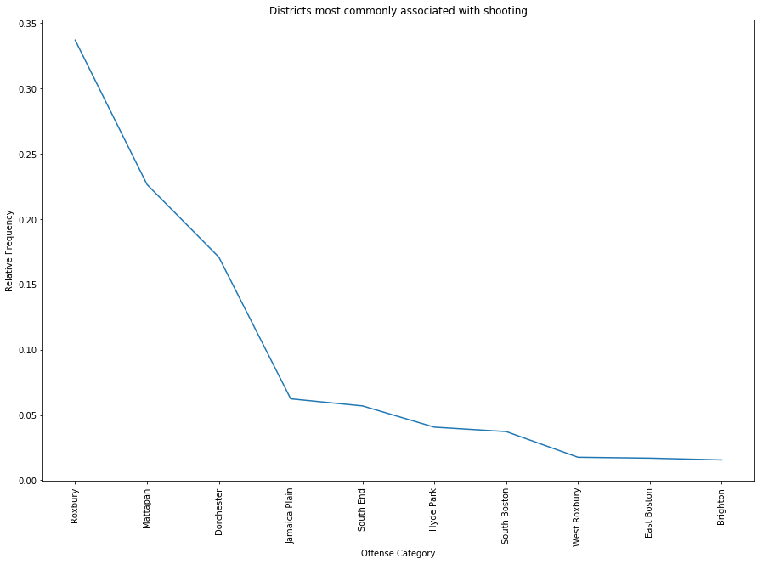
4. Which districts are most commonly associated with a shooting incident?

Slide 9
Conclusion
Are people more likely to be involved in motor accidents than anything else?
Roxbury, Mattapan, and Dorchester seem to be very unsafe.
Night-time is particularly unsafe.
Future Work:
Merge with information about population and the area each district and normalize values accordingly.
Analyze the trend of change in certain crimes over the past few years.
Maybe relate the trend with relevant laws which were passed to observe the changes?

Slide 10
Thank You
Questions?

